Slide 1
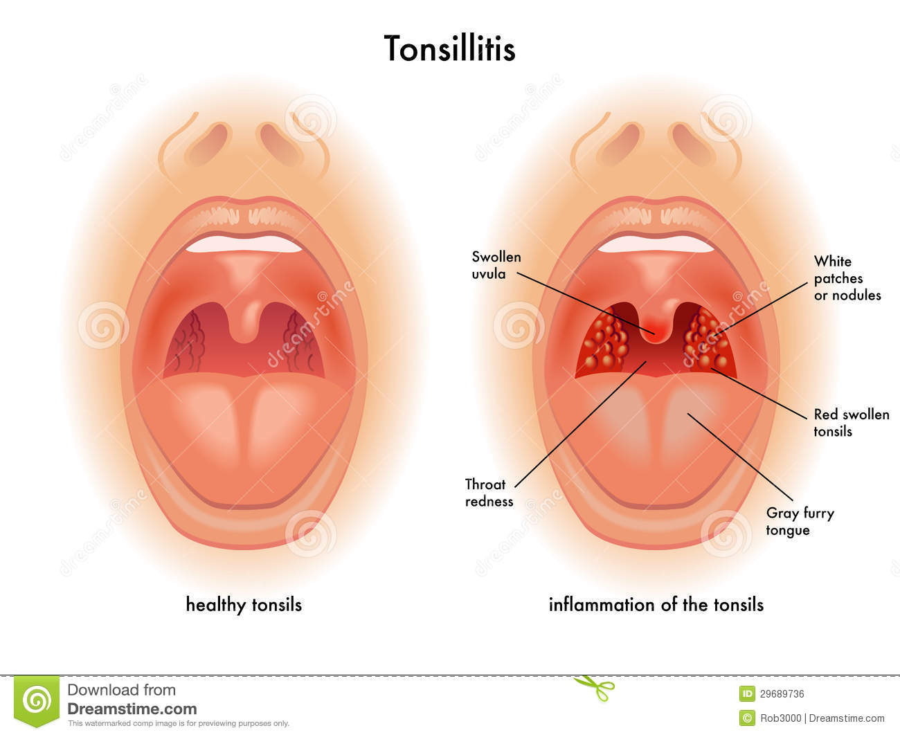
ADENIODITIS/TONSILITIS

Slide 2
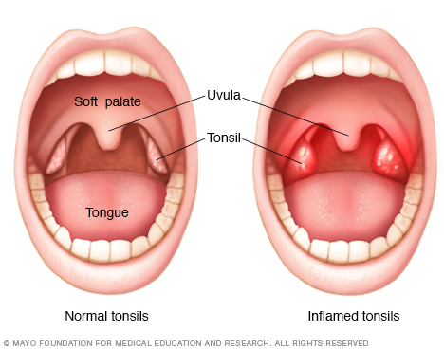
What are Adenoids and Tonsils?
Tonsils are two small masses of lymphoid tissue one on each side of the root of the tongue.
The faucila and lingual tonsils are located behind the pillars of the fauces and tongue respectively. They frequently serve as the acute infection.
Acute tonsillitis can be confused with acute pharyngitis.
Chronic tonsillitis is less common and may be mistaken for other disorders such as allergy, asthma and rhino sinusitis.

Slide 3
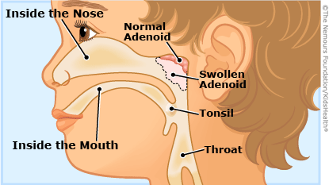
What are Adenoids and Tonsils?
The adenoids or pharyngeal tonsils consist of lymphatic tissue near the center of the posterior wall of the naso-pharynx.
Infection of the adenoids frequently accompanies the acute tonsillitis.
Frequently occurring bacterial pathogen include GABHS, the most common organism.
The most common viral pathogen is Epstein-barr virus although cytomegalovirus may also cause tonsillitis and adenoiditis can occur in adults.

Slide 4
What Causes Adenotonsilitis?
Adenotonsilitis is caused by a viral or bacterial infection.
Adenovirus,
Influenza Virus,
Par influenza and
Streptococcus species of bacteria are the commonest organisms involved.

Slide 5
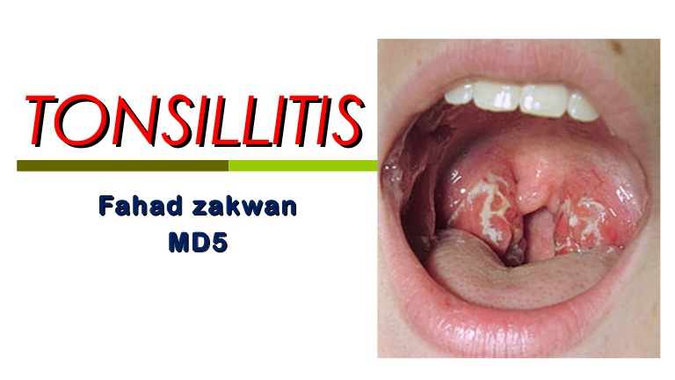
How is Adenonsilitis Spread to Other People?
The virus and bacteria that cause Adenotonsilitis are airborne and thus easily spread to other individuals.

Slide 6
Signs and Symptoms of Adenotonsilitis?
The symptoms are
fever,
sore throat,
swollen tonsils that are red and may have white spots on them,
difficulty swallowing.
This is associated with coughing,
headache,
At times children may have nausea, vomiting, hoarseness, and bad breath.
Enlarged adenoids may cause mouth breathing, earache, draining ears, children have blocked nose, nasal discharge, snoring and mouth breathing.
In the event the tonsils and adenoids are very large and obstruct (block) the airway, the child may have a sudden difficulty to breathe while she is asleep. This phenomenon is called Obstructive Sleep Apnea.
The infection also may reside in the middle ear as a chronic low grade, smoldering process that eventually may cause permanent deafness.

Slide 7
ASSESMENT AND DIAGNOSTIC FINDINGS
Diagnosis is primarily clinical with attention given to whether the infection is viral or bacterial in nature.
As In acute pharyngitis, RADT is quick and convenient however it is less sensitive than the throat swab culture.
A thorough physical examination is performed and careful history is obtained to rule out related or systemic conditions
The tonsillar site is cultured to determine the presence of bacterial infection.
When cytomegalovirus infection is present, the differential diagnosis should include HIV, hepatitis A and rubella.
In adenoiditis, if recurrent, episodes of suppurative otitis media result in hearing loss, comprehensive audiometric assessment is warranted.

Slide 8
MANAGEMENT OF ADENOIDITIS AND TONSILITIS
Tonsillitis is treated with supportive measures that include
increased fluid intake,
Taking analgesics ( paracetamol or ibuprofen helps to reduce fever and pain.)
salt water Gargles and/or lozenges help to reduce pain in older children and rest.
If bacterial infection is suspected, a course of antibiotics is given. If this treatment does not settle the fever and sore throat than the patient will need to be admitted into hospital for intravenous antibiotics.
Most of the time, Adenotonsilitis gets better within a week. However, a small number of children have tonsillitis for longer, or it keeps returning.
Thus surgical treatment may be needed.
Tonsillectomy and adenoidectomy continue to be commonly performed surgical procedures aimed at reducing complications and improving post-operative recovery.

Slide 9
MANAGEMENT OF ADENOIDITIS AND TONSILITIS
Patients who experience no adverse events for six hours have a low overall risk of later bleeding and other complications.
These procedures are indicated the patients who have had
repeated episodes of tonsillitis despite antibiotic therapy,
hypertrophy of tonsils and adenoids that could cause obstruction and
obstructive sleep apnea,
repeated attacks of purulent otitis media and
suspected hearing loss due to serious otitis media that has occurred in association with enlarged tonsils and adenoids.

Slide 10
MANAGEMENT OF ADENOIDITIS AND TONSILITIS
Indications for adenotonsilectomy include
chronic nasal airway obstruction,
chronic rhinorrhea,
obstruction of the Eustachian tube with related ear infection and
abnormal speech.
Surgery is also indicated if the patient has developed a peritonsillar abscess that occludes the pharynx, making swallowing difficult and endangering the patency of the airway.

Slide 11
NURSING MANAGEMENT
Providing post-operative care
Continuous nursing observation in the immediate post-operative the recovery period because of the risk of infection and hemorrhage which may also compromise the patients airway. Prone position is the most comfortable after the operation.

Slide 12
Educating patient about self-care.
Tonsillectomy and adenoidectomy are usually performed as outpatient surgery and patient tis sent home from the recovery room once they are awake, oriented are able to drink liquid and void.
The patient and family must understand the signs of hemorrhage.
Health education about taking full dose of antibiotics is important.
Alkaline mouthwash and warm saline solutions are useful in coping with thick mucus and halitosis that maybe present after surgery.
Patient should eat an adequate diet with soft food patient should avoid spicy hot or acidic rough food.
Milk and milk products may be restricted because they make removal of mucus difficult for some patients.
Nurse instructs the patient about the need to maintain good hydration Patient advised to abstain from vigorous tooth brushing or gargling because these activities can cause bleeding.
The patient should avoid smoking and heavy lifting or exertion.

Slide 13
What are the Complications of Adenotonsilitis?
The possible complications are:
Middle ear infection known as Otitis Media where the fluid between the eardrum and inner ear becomes infected by bacteria.
A collection of pus develops between one of the tonsils and the wall of the throat. This is called peritonsillar abscess or Quinsy.
Rarer complications are:
Obstructive sleep apnoea (as explained earlier)
Glomerulonephritis 10 to 14 days after streptococcal tonsillitis. This occurs as a result of the body’s immune system's reaction to the infection.

